Slide 1
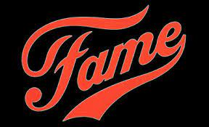


Collaboration Basics from the High School of Performing Arts
Stop Video at 0:57.
10 October 2025
Robert Snyder
Founder & President, Innovation Elegance, LLC

Slide 2


Inspiration
“Not finance. Not strategy. Not technology. It is teamwork that remains the ultimate competitive advantage, both because it is so powerful and so rare.”
- Patrick Lencioni

Slide 3
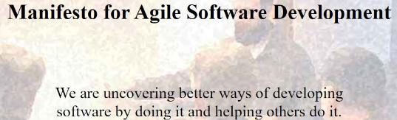

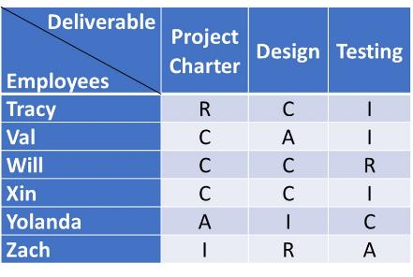
Inspiration: Sacred Cows
Elegance Manifesto
We are uncovering better ways of innovation teamwork by doing it and helping others do it.
meeting minutes
RACI

Slide 4
Scope & Curriculum Plan
Improv
Collaborative
Music
Cost Profile
Competitive
Partner Dance
Audience
Theater
Creativity
The combination of two or more things that, previously, you thought were unrelated.
Documentation
Factory | Flywheel
WIIFM: high success rates

Slide 5
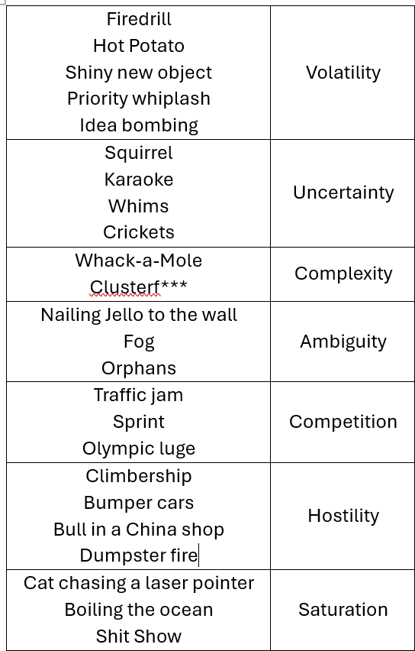
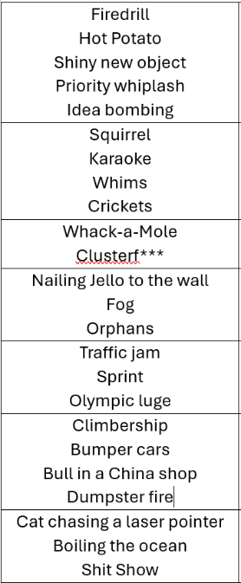
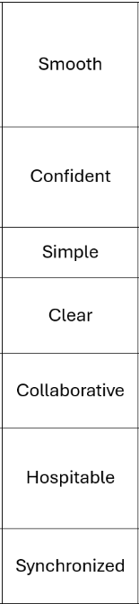
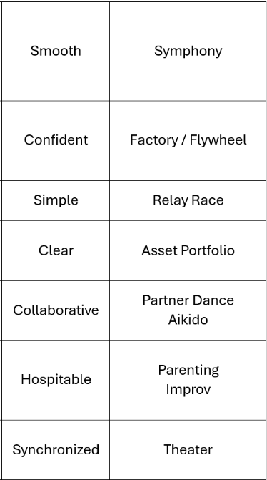
Herding cats
Metaphors

Slide 6
Single standard
Inspiration
Where is the bully (creep)?
What are we?
Herding cats
Metaphors
Easy to overtly opt out
Hard to covertly opt out
Fail Fast
High success rates

Slide 7

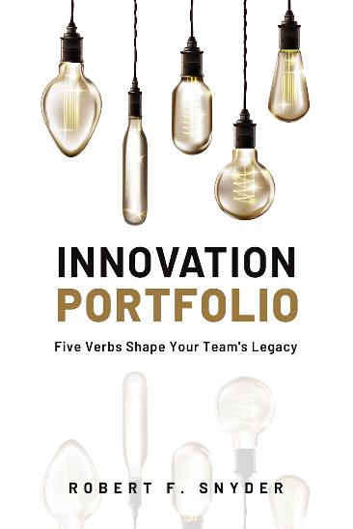
Deep Dive of Material
Agreement Factory
Empathetic / Performing Arts
Asset Portfolio (Documentation)

Slide 8
Graduation Requirements | Takeaways
Working Software
Working Team
Chaos
Cruelty
Discipline
Empathy
VUCA
Elegance
Communication
Traffic
Jams
Asset
Portfolio
© 2025 Innovation Elegance, LLC
Meeting
Gridlock
Email
Overload
Agreement
Factory
Performing
Arts
Teams resemble
Frustration Factories
Teams resemble
Elegant Expectation Factories

Slide 9
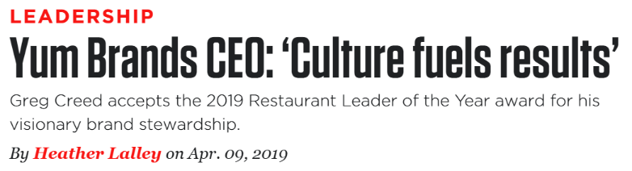
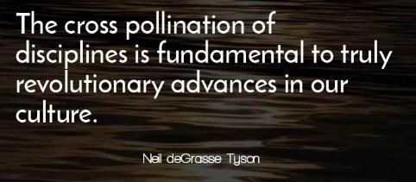
“Placing” Culture & Cross Pollination
Structure
Cross pollination
Strategy
Culture
Cross pollination
Culture
Strategy
Structure

Slide 10
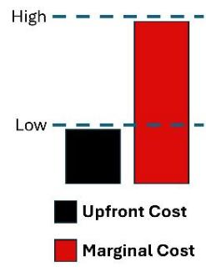
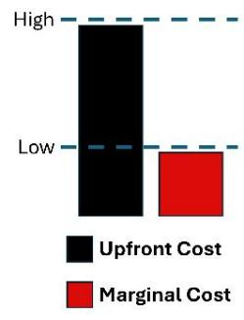
High Traffic
Economics of Culture & Communication Channels
Low Traffic
Talk
Walk

Slide 11
Economics of Culture
Low Discipline
Low Empathy
High Discipline
High Empathy

Slide 12
Economics of Culture
Toxic environment
High psychological safety

Slide 13
Economics of Culture
“Do what is easy and your life will become hard.
Do what is hard and your life will become easy.”
“You can ignore the laws of gravity, but the laws of gravity don’t ignore you.”
You can ignore the laws of marginal cost, but the laws of marginal cost don’t ignore you.”

Slide 14
Economics of Culture – Hybrid
No scale
PMO is overkill
Scale
PMO aims for scale

Slide 15
Economics of Culture – Hybrid
Immaturity
Maturity

Slide 16
Economics of Culture – Hybrid
Stodgy
Old-fashioned
Not sexy
Hip
On the frontier
Sexy

Slide 17
Economics of Culture
Stop Video at 4:45.
Painful work
Hard work

Slide 18
Collaborative Advantage
Who else?
“Empathy is the engine that powers all the best in us. It is what civilizes us.”
Meryl Streep
American Actress
What else?
“Empathy is the ultimate form of customer insight.”
Don Peppers
American author and professor of marketing
Who do you care about?
“If the world runs out of ideas, then
productivity gains translates to job loss.”
Jensen Huang
CEO, Nvidia

Slide 19
Trust: Ten Tools to Not Leave It to Chance
Competence
Honesty
Dependability
Benevolence
Discipline
Empathy
Self-esteem
Humility
Lessons
Learned
ORS
Parking
Lot
I Like I Wish
I Hope I Wonder
Stoplight
Report
Workload
Report
Individual
Status Report
Pie
Chart
Change
Log
Approachability
Menu
“Get comfortable being uncomfortable.”
Tools to make the untrustworthy uncomfortable
Afflict the untrustworthy
Incompetent | Malevolent

Slide 20
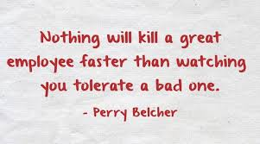
Economics of a Culture of Trust
Tolerance for the
untrustworthy
Intolerance for the untrustworthy

Slide 21
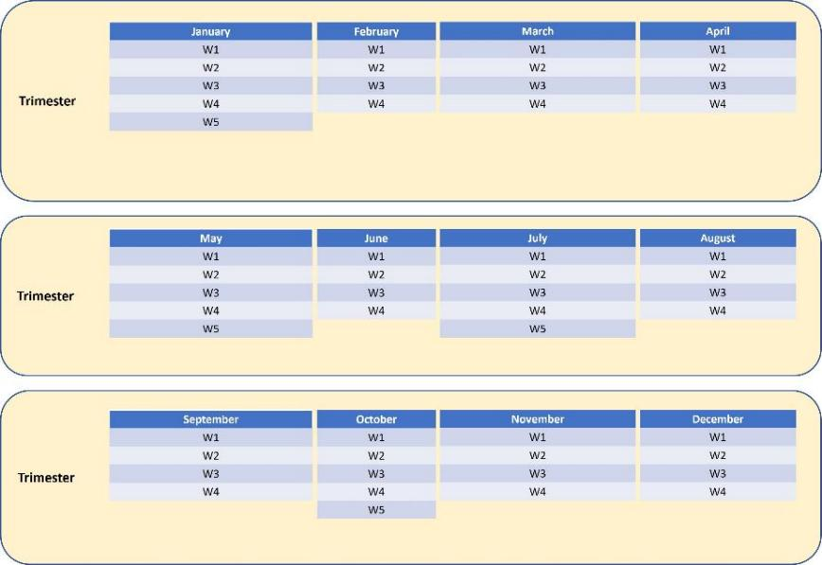
Legacy of Low Trust – Collaborative Disadvantage
Meeting Minutes
Easy
Immature
Talk
Reactive
Infinite & Infinite Activity
Reinventing the wheel
Low glamour
Order Taker
Low skills visibility
Bad for LinkedIn profile
Legacy?
Inheritance?

Slide 22
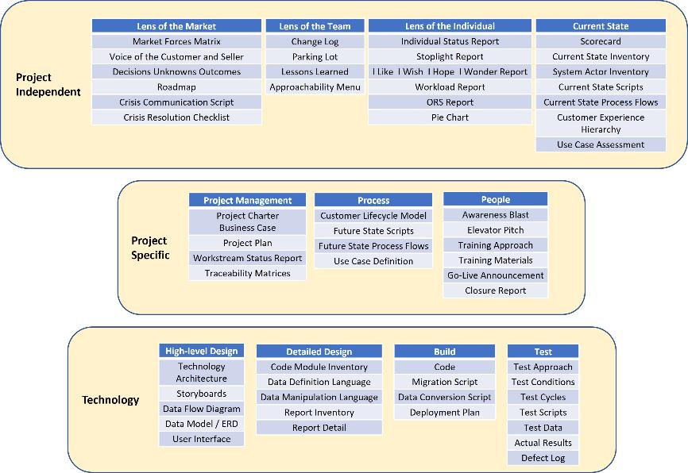
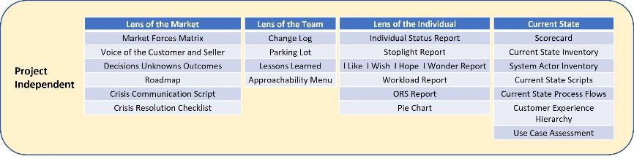
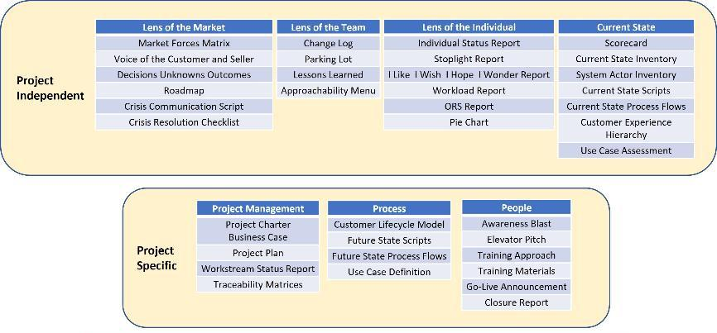
Legacy of High Trust – Collaborative Advantage
Asset Portfolio
Hard
Prompts
Maturity
Good friction
Certainty
Walk
Proactive
Finite Productivity
Glamorous
High skills visibility
Internal mobility
Career growth
No harboring incomp
Legacy
Love letter

Slide 23
Four Adjectives → Five Verbs
Draft
Review
Revise
Approve
Distribute
Responsible
Accountable
Consulted
Informed
Draft
Approve
Review & Revise
Distribute
“Dr. RAD”

Slide 24

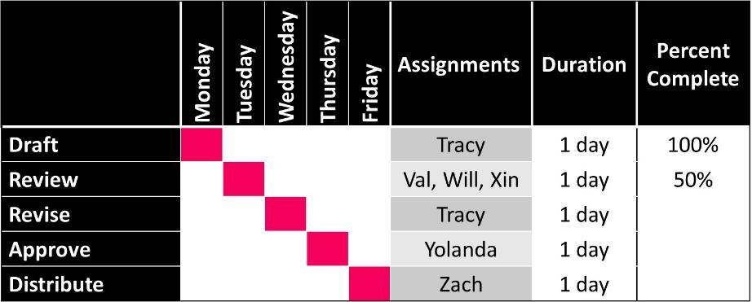
Five Verbs = a RACI With Teeth
Sequence
Duration
Closure
Forced Collaboration
Easy to overtly opt out
Explicit ≠ Rigid
Factory of Agreements / Expectations
Productivity versus Activity
Discourages micro-managing

Slide 25

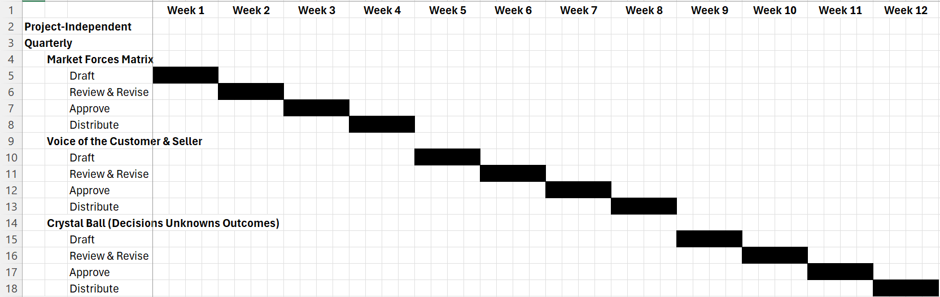
Habits: A Rhythm of Trust (Quarterly)
“Execution’s two best friends are simplicity and transparency.”
- Chris McChesney, author of The 4 Disciplines of Execution
Explicit ≠ Rigid

Slide 26
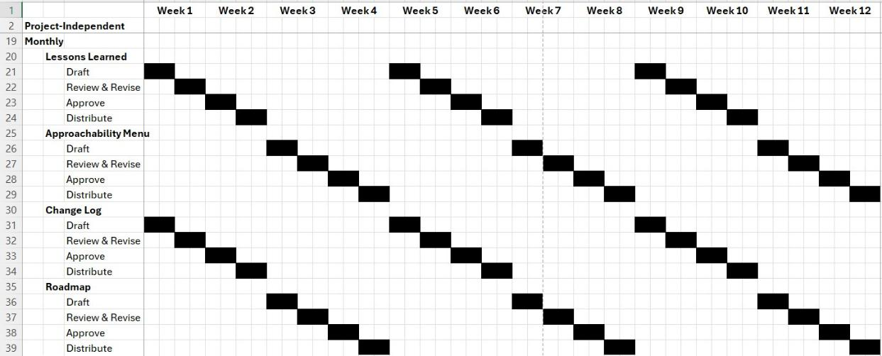
Habits: A Rhythm of Trust (Monthly)
“The synchronization skill of the boss dictates the speed of the team.”

Slide 27
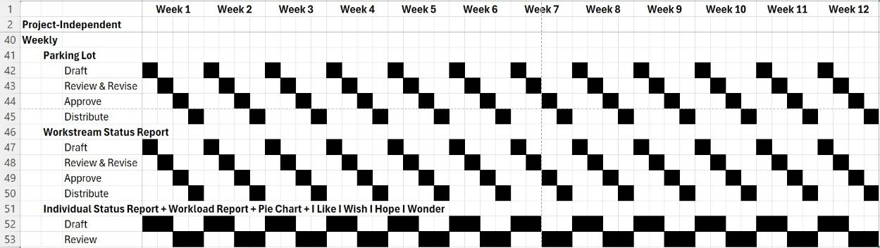
Habits: A Rhythm of Trust (Weekly)
“Practice puts brains in your muscles.”
- Samuel Snead, American professional golfer

Slide 28



Invert How You Treat Speed
Leading Culture Trait
Lagging Culture Trait
Traffic Jam
Synchronization
“You can ignore the laws of synchronization,
but the laws of synchronization do not ignore you.”

Slide 29
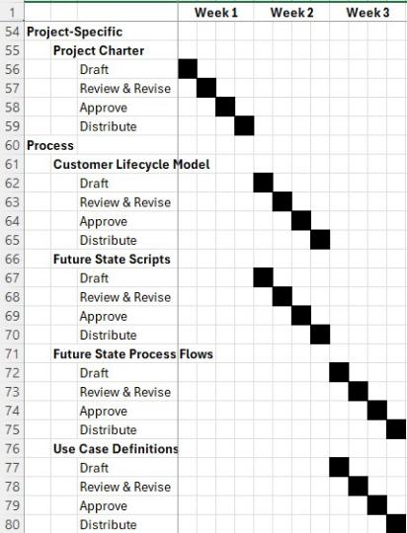
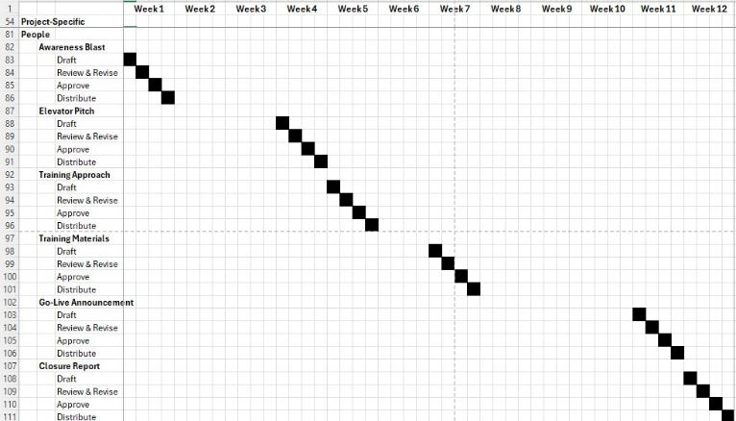
Habits: Project Pacing | Process & People
Anticipate analysis paralysis
No micro-management
“Smooth is fast.”

Slide 30
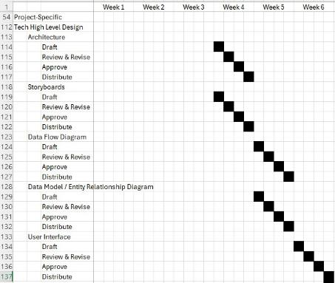
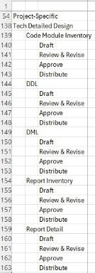
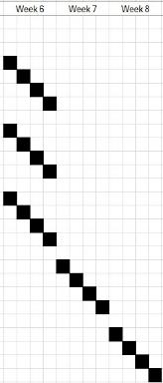
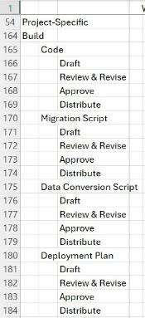
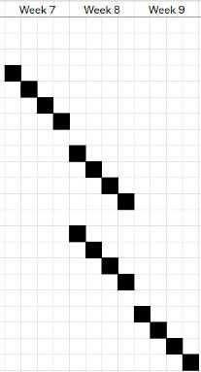
Habits: Technology
High Level Design
Detailed Design
Build
“The best way to learn is through the powerful force of rhythm.”
~ Wolfgang Amadeus Mozart

Slide 31
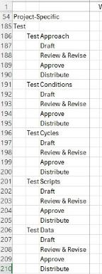
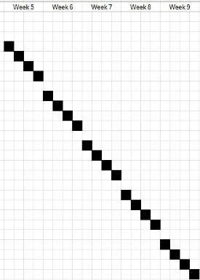
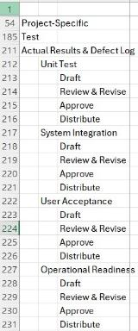
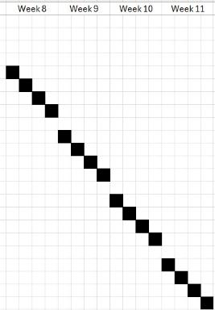
Habits: Technology
Test Preparation
Test Execution
“Repetition is the mother of learning, the father of action, which makes it the architect of accomplishment.”

Slide 32
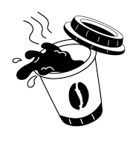
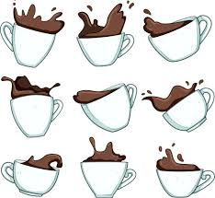
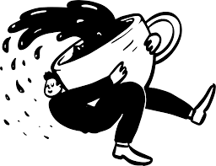
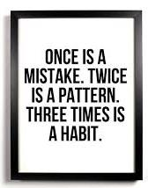
Errors
Resilient
Doormat
Bullied
Sampling
Systemic
Systematic
“GETMO”
Good enough to move on
Perfect
Perfect Intentions
“Elmo”
Enough, let’s move on

Slide 33
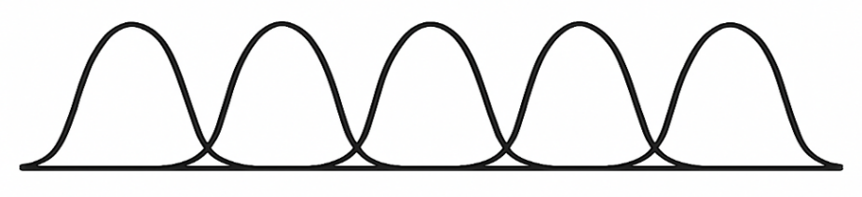
Handoffs Bring Out the Best
Draft
Review
Revise
Approve
Distribute
“None of us is smarter than all of us.”
“Love is simple: it’s people doing their best to bring out the best in each other.”
“There is a time and place for your exotic vocabulary. Your project plan is not that place.”

Slide 34
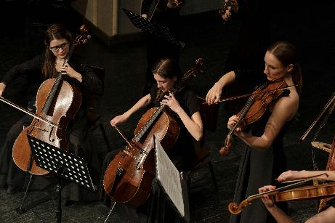


Competitive Advantage | Ambition
Balance
Rejection
Resilience
“The road to success is paved with mistakes well-handled.”
- Daniel Coyle, author of The Talent Code and The Culture Code

Slide 35
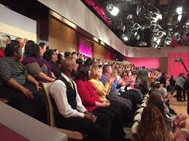
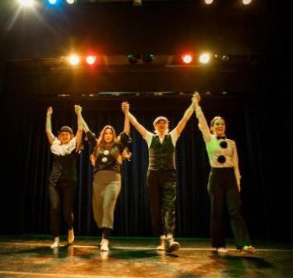
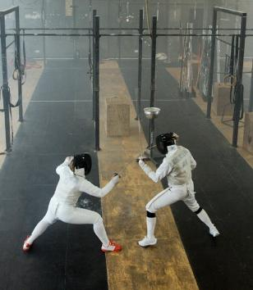
Artist Audience Intersection
Stop video at 1:42
Performance
Celebration
Moments That Matter
Magic
“The idea is not to live forever, but to create something that will.”
- Andy Warhol, American visual artist

Slide 36
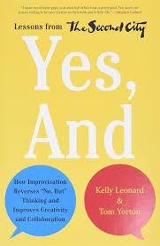


Improv
Yes, And
Bring a Brick Not a Cathedral
Positive Surprises
“Good improv is all about listening, reacting in the moment,
creating, and supporting the ideas of others.”
- Tom Yorton, co-author of Yes, And and former CEO of Second City Works

Slide 37
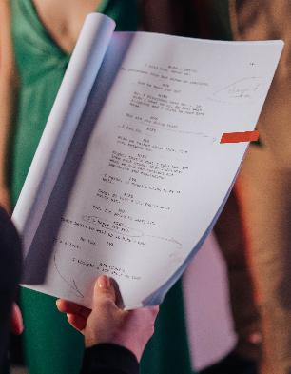
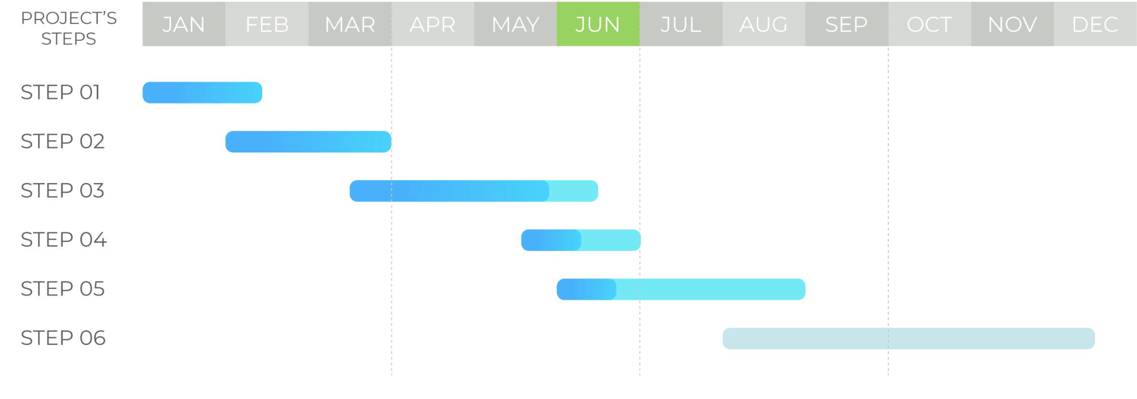
Theater
Story
Integration
(Dr. Arden Dudek)
Not reinventing the wheel
“What is innovation but rewriting our customer’s story?”

Slide 38
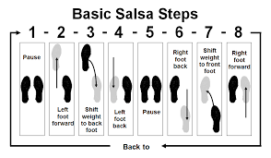
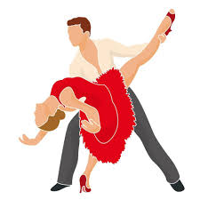
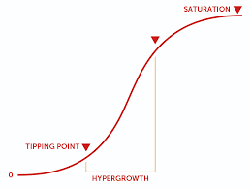
Partner Dance
Mechanics versus Style
Servant Leadership
Learning Never Stops
“This is my dance space. This is your dance space.”
- Johnny Castle, movie character played by Patrick Swayze

Slide 39

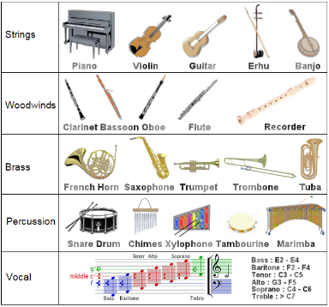

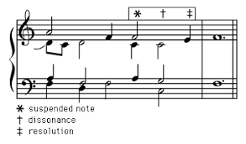
Music
Hardest profession
Stop video at 7:38
Diversity
Pacing
Optimism | Best Seat
“A symphony must be like the world. It must contain everything.”
- Gustav Mahler, Austrian composer and conductor

Slide 40
Trait | Leadership Paradigm | Values & Principles | Metaphors
Psychologically safe to reject
No
Yes
Overtly opting out
Difficult
Easy
Inspiration
Covertly opting out
Easy
Difficult
Harbor inauthenticity & lip service
Yes
No
Easy to detect opting out
No
Yes
Easy to assign ownership of opting out
No
Yes
Harbor double standards
Yes
No
“For Thee Not For Me”
Yes
No
Leave trust to chance
More
Less
Proactively govern untrustworthy actors
No
Yes
Consequences for being untrustworthy
Low
High
Tolerate a bad, hostile employee
Yes
No

Slide 41
Trait | Leadership Paradigm | Values & Principles | Metaphors
Psychologically safe to reject |  | No | Yes
Overtly opting out |  | Difficult | Easy
Covertly opting out |  | Easy | Difficult
Harbor inauthenticity & lip service |  | Yes | No
Easy to detect opting out |  | No | Yes
Easy to assign ownership of opting out |  | No | Yes
Harbor double standards |  | Yes | No
“For Thee Not For Me” |  | Yes | No
Leave trust to chance |  | More | Less
Proactively govern untrustworthy actors |  | No | Yes
Consequences for being untrustworthy |  | Low | High
Tolerate a bad, hostile employee |  | Yes | No
Inspiration

Slide 42
Methodology Debt | Infrastructure | Human Intel Hype
 | Traditional | Agile | Hybrid | Elegance
Scope Size | Large | Small
Documentation | More | Less | Infinite | Finite
Frequency | Low | High
Speed | Slow No Hurry | Fast Hurry |  | Synchronization
Predictability | Predictive | Adaptive | Predictive OR Adaptive | Predictive AND Adaptive
Cost Profile |  | Just barely good enough | Low Upfront Cost High Marginal Cost | Low Marginal Cost Infrastructure
Metaphor |  | Traffic Jam Speed is leading culture trait |  | Symphony Speed is a lagging trait
Relationship between Authority & Accountability | Uncoupled |  |  | Coupled
Forms of Speech in Project Plan | Four Adjectives (RACI) + Verb Sprawl |  |  | Five Verbs
Minimize Idle _________ | Workers |  |  | Work
VUCA | Increasing |  |  | Decreasing
Tolerate Double Standards? | Yes |  |  | No
 | Traditional | Agile | Hybrid | Elegance
Scope Size
Documentation
Frequency
Speed
Predictability
 | Traditional | Agile | Hybrid | Elegance
Scope Size | Large
Documentation | More
Frequency | Low
Speed | Slow No Hurry
Predictability | Predictive
 | Traditional | Agile | Hybrid | Elegance
Scope Size | Large | Small
Documentation | More | Less
Frequency | Low | High
Speed | Slow No Hurry | Fast Hurry
Predictability | Predictive | Adaptive
 | Traditional | Agile | Hybrid | Elegance
Scope Size | Large | Small
Documentation | More | Less | Infinite
Frequency | Low | High
Speed | Slow No Hurry | Fast Hurry
Predictability | Predictive | Adaptive | Predictive OR Adaptive
Cost Profile |  | Just barely good enough | Low Upfront Cost High Marginal Cost
Metaphor |  | Traffic Jam Speed is leading culture trait
Relationship between Authority & Accountability | Uncoupled
Forms of Speech in Project Plan | Four Adjectives (RACI) + Verb Sprawl
Minimize Idle _________ | Workers
VUCA | Increasing
Tolerate Double Standards? | Yes

Slide 43
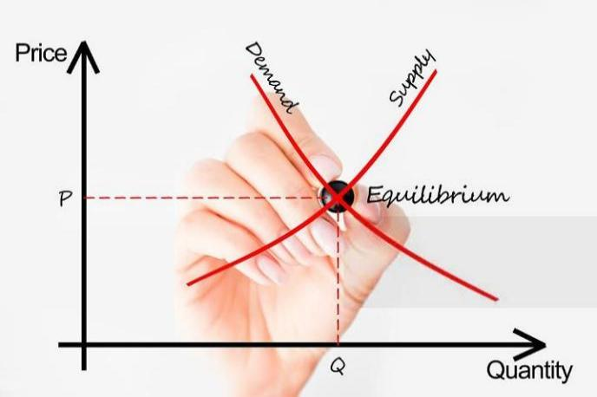
Success Rate Impact on Job Market
Confidence ↑
Demand curve →
Employee Retention ↑
Supply curve →
Idle Work ↓
Idle Workers ↓
Innovation Debt ↓
Authored by Innovation Elegance, LLC

Slide 44

Convert RACI to Five Verbs
Convert Verb Sprawl to Five Verbs
1
7
2
6
5
4
3
Documentation Debt
Low morale
Relationship Problems
Simply don’t know
Increase work
Decrease work
Low engagement
Too much tech
8
10
9
Adoption
Approach
Authored by Innovation Elegance, LLC

Slide 45
Graduation Requirements | Takeaways
Working Software
Working Team
Chaos
Cruelty
Discipline
Empathy
VUCA
Elegance
Communication
Traffic
Jams
Asset
Portfolio
© 2025 Innovation Elegance, LLC
Meeting
Gridlock
Email
Overload
Agreement
Factory
Performing
Arts
Teams resemble
Frustration Factories
Teams resemble
Elegant Expectation Factories

Slide 46




Books | Case Studies | Feedback
Robert Snyder
rsnyder@innovationelegance.com
www.linkedin.com/in/rsnyder7/

